Slide 1
NER for acknowledgments
Sebastian Deręgowski
Klaudia Gruszkowska
Dawid Janus
Bartosz Jamroży

Slide 2
Goal of the project
The aim of our project was to develop and evaluate named entity recognition (NER) models for identifying and classifying entities in acknowledgements.
We built our work on the foundations of the paper written by Smirnova N., Mayr P. “Embedding models for supervised automatic extraction and classification of named entities in scientific acknowledgements”.

Slide 3
Significance of the project
We trained several different NER models and evaluated their behaviour.
Additionally we manually gathered acknowledgements from 243 papers and created silver standard set based on model’s prediction. We proved that silver standard can be efficient and improve training process.

Slide 4
Research questions
What techniques and models in the field of NLP are most effective for recognising named individuals in a specific area?
How does the performance of NER models change with different types and amounts of training data?
Can the use of different text normalisation techniques, such as lemmatization or stop word removal, improve the effectiveness of NER models in identifying entities in scientific acknowledgement texts?
Can preparing a silver-set and further training models on it improve their effectiveness?
Which types of entities are the most difficult to classify?

Slide 5
EDA

Slide 6
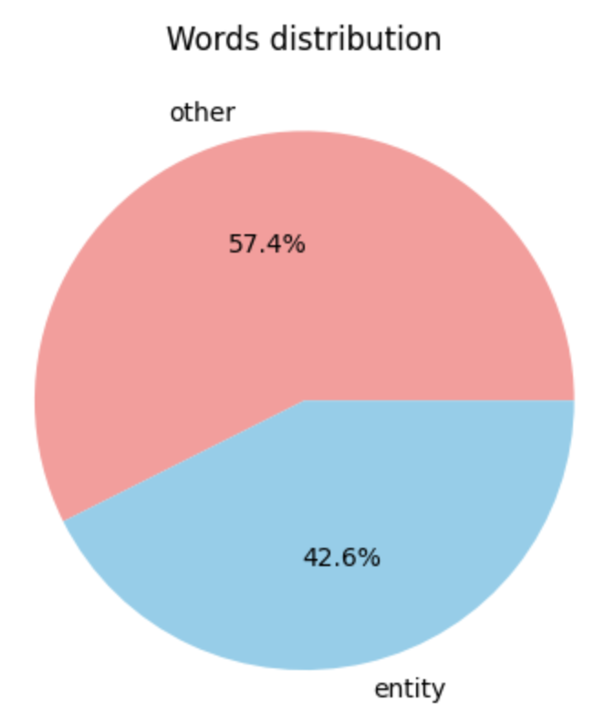

Slide 7
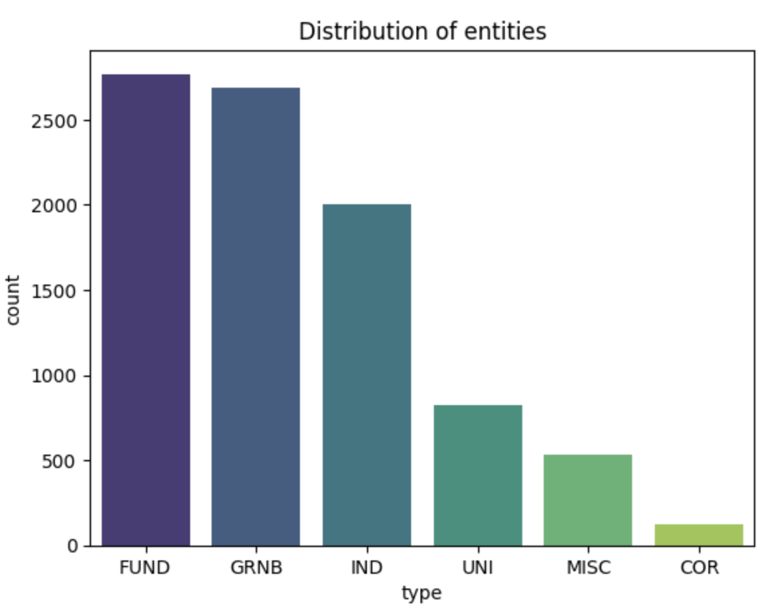

Slide 8
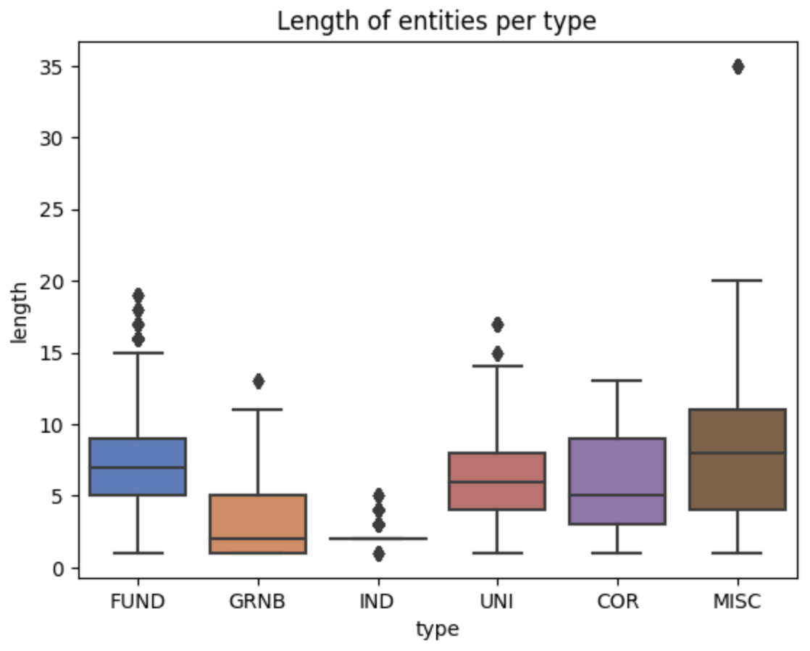

Slide 9
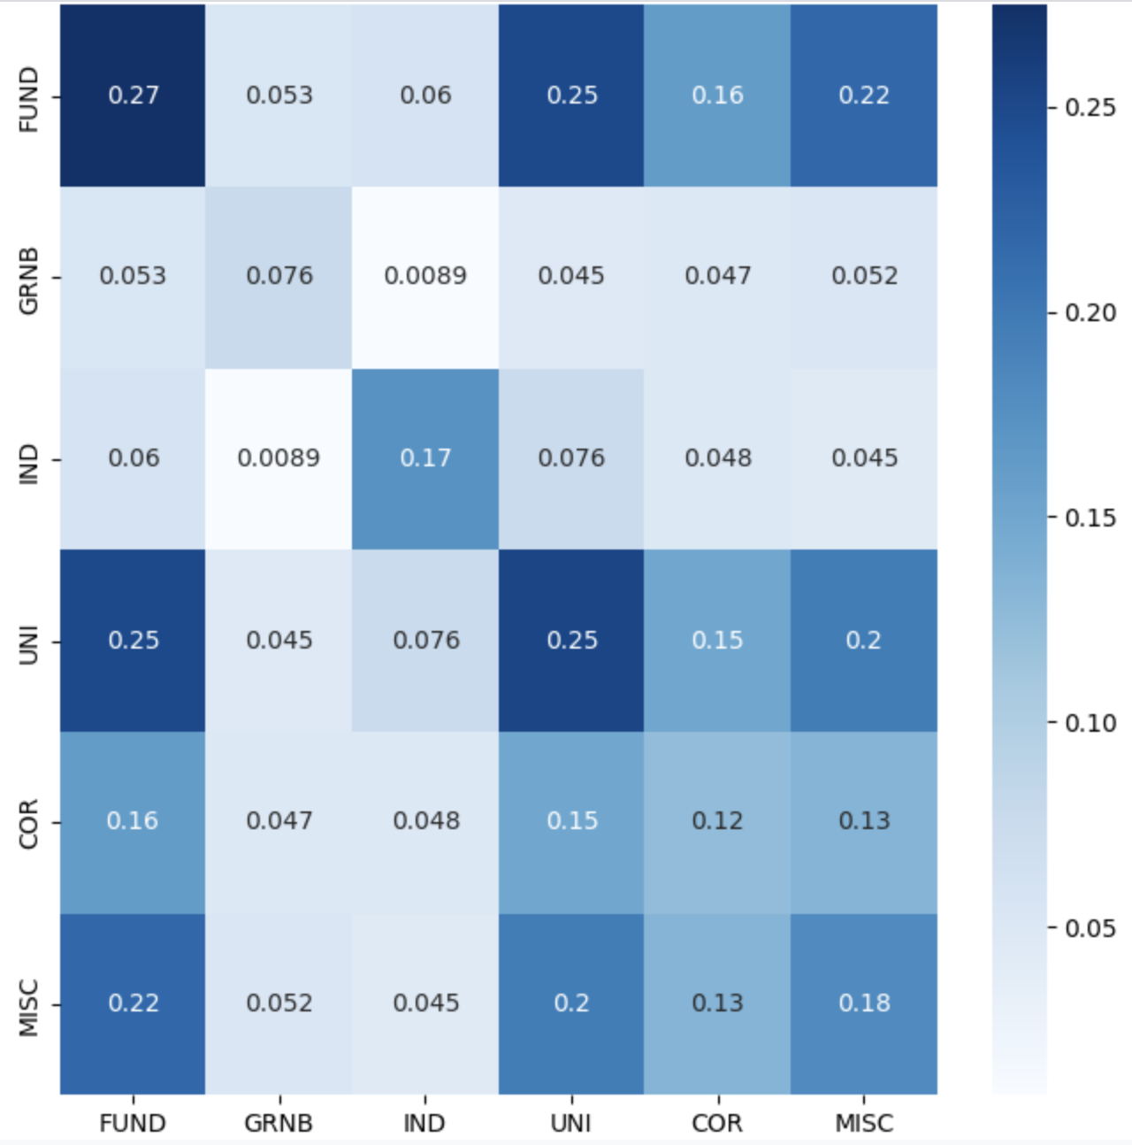

Slide 10
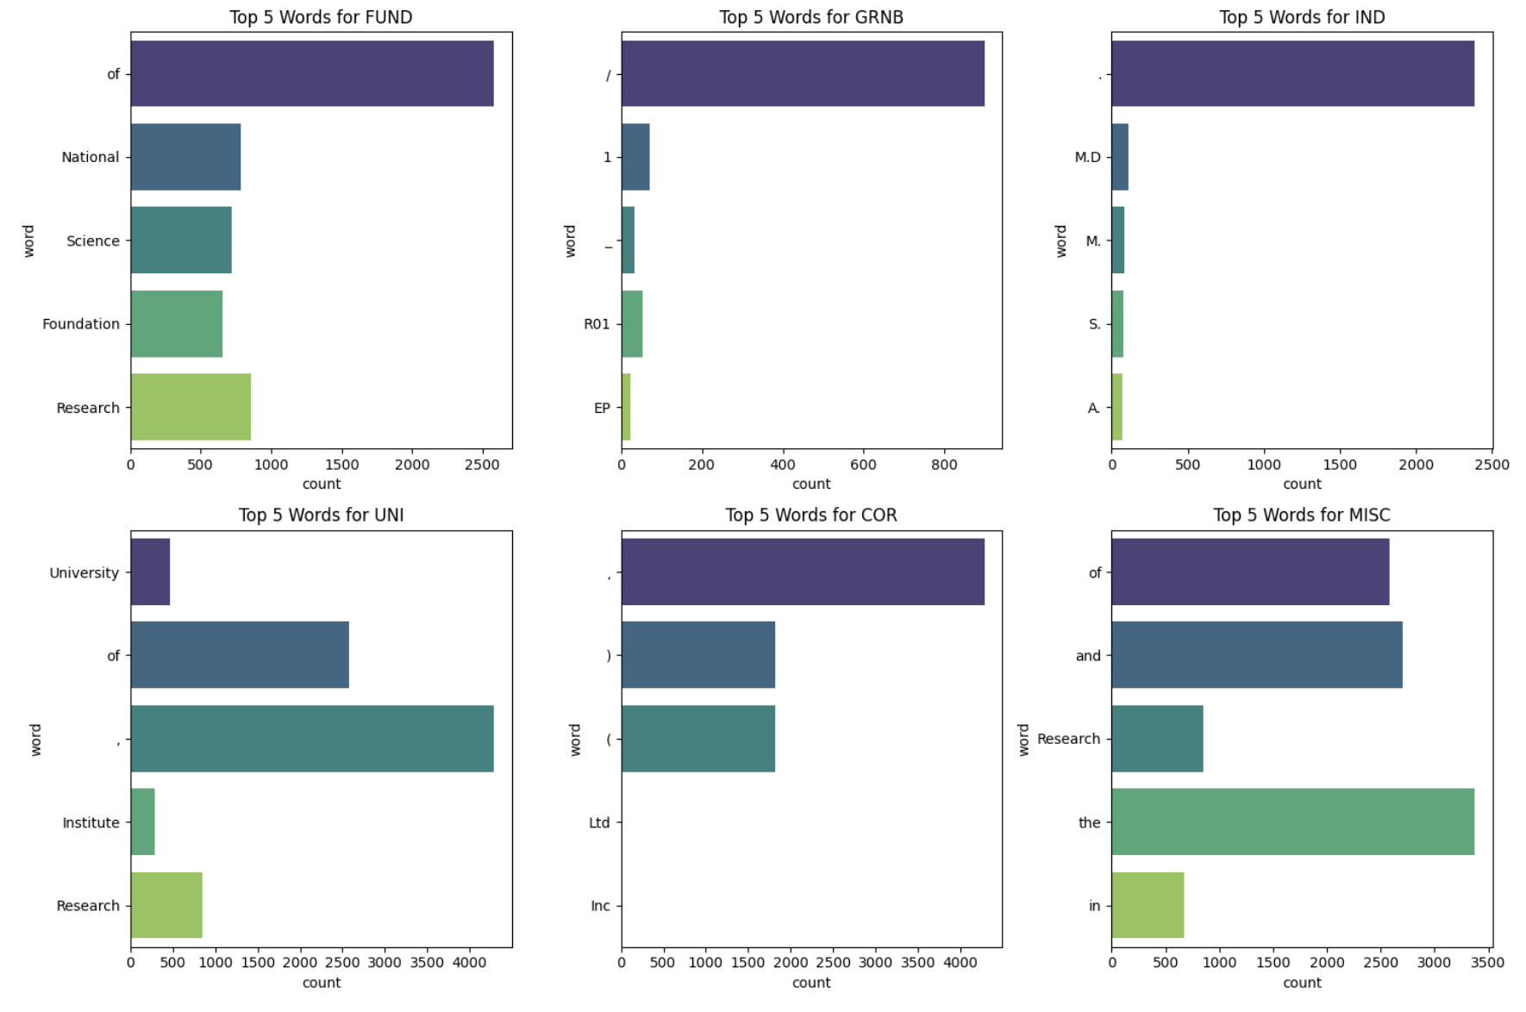

Slide 11
Models

Slide 12
Models
Flair Embeddings
BERT
XLNet (base and large)
In addition, we tried to train the TARS model, unfortunately, we did not achieve comparable results on it.

Slide 13
Flair Embeddings
NER model with Flair Embeddings is a method which create contextual word embeddings for text data
This method consider the surrounding words and the context in which a word appears
Gives different embeddings for the same word depending on its surrounding text
This is achieved through the use of two-way Long Short-Term Memory (LSTM) models, enabling Flair to capture complex relationships between words

Slide 14
BERT - Bidirectional Encoder Representations from Transformers
Transformer architecture
Model use attention mechanism, which is a way for a model to assign weight to input features based on their importance to some task.
Before feeding word sequences into BERT, 15% of the words in each sequence are replaced with a [MASK] token. The model then attempts to predict the original value of the masked words, based on the context provided by the other, non-masked, words in the sequence.

Slide 15
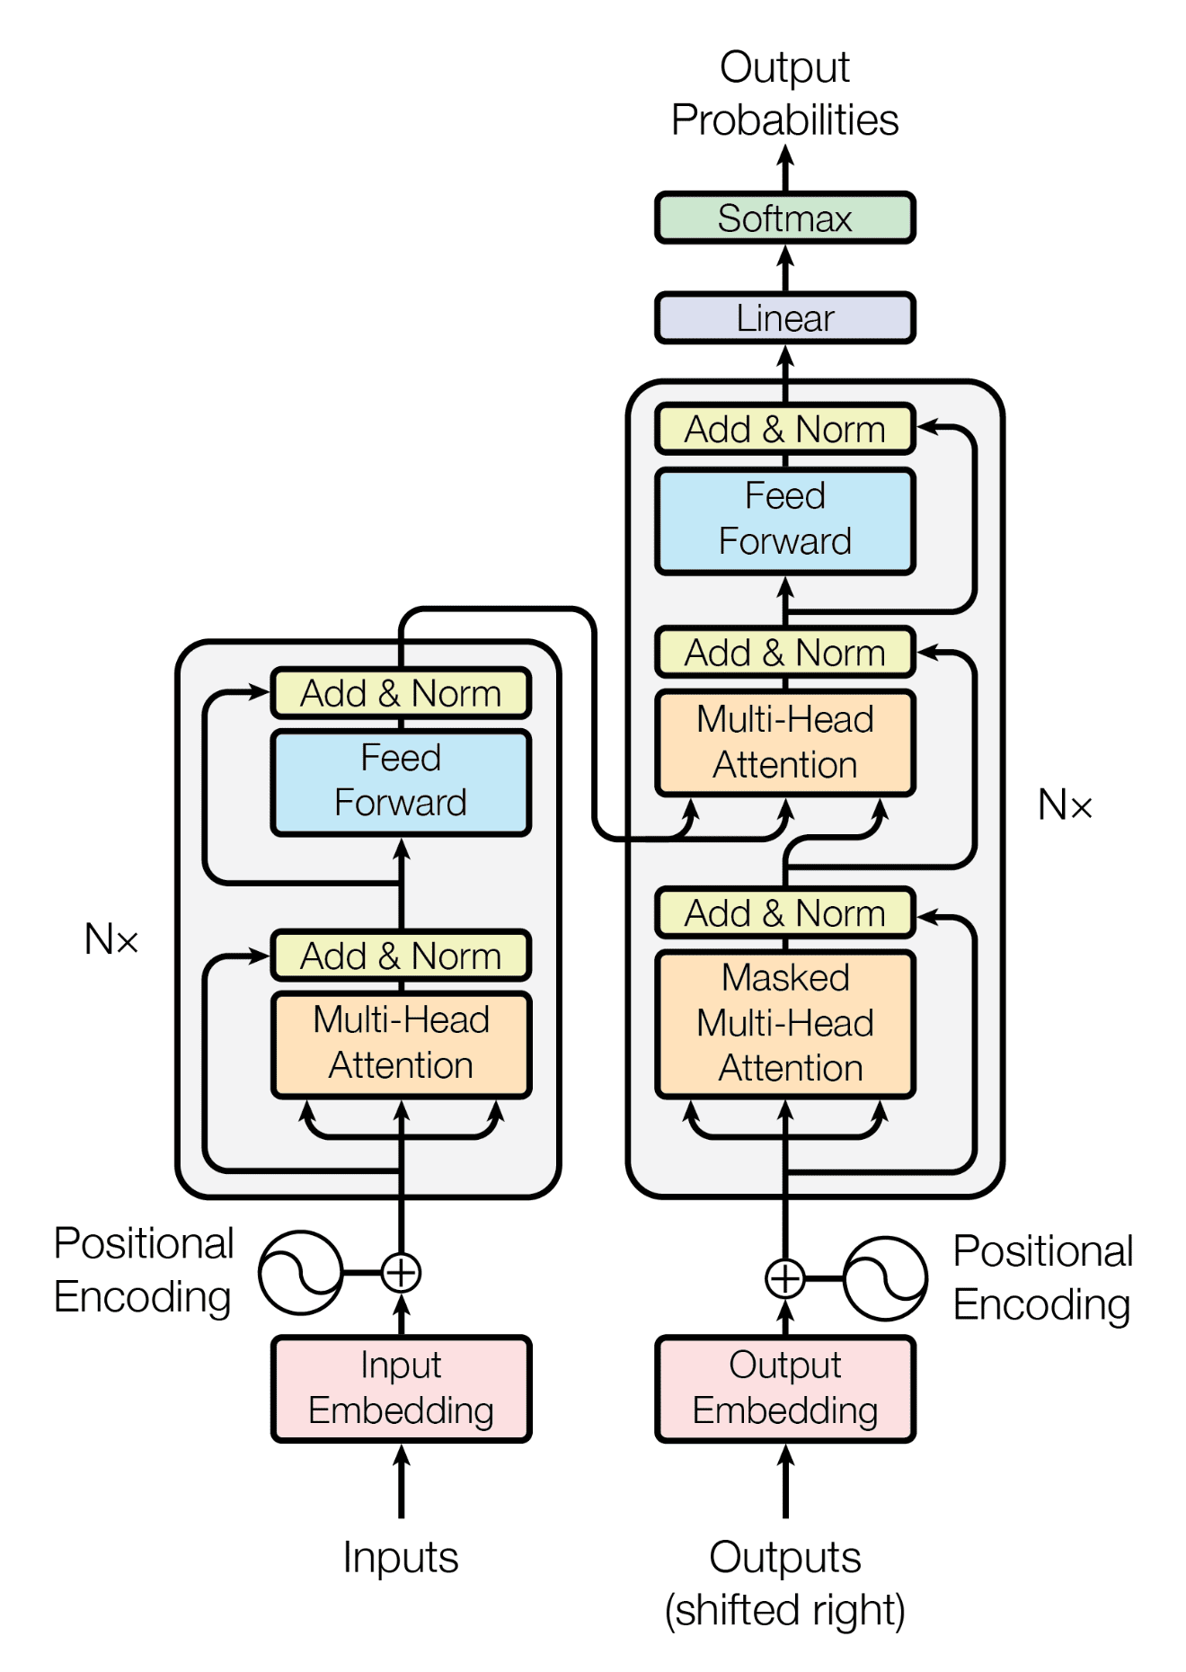
Transformer model
Source: Ashish Vaswani and Noam Shazeer and Niki Parmar and Jakob Uszkoreit and Llion Jones and Aidan N. Gomez and Lukasz Kaiser and Illia Polosukhin “Attention Is All You Need” , arXiv:1706.03762

Slide 16
XLNet - eXtreme Language understanding NETwork
Transformer architecture
XLNet consider all possible permutations of the input sequence during training. This enables the model to learn dependencies between all words, regardless of their position.
The Architecture of XLNet consists of a stack of Transformer layers. Each layer comprises multi-head self-attention mechanisms and feed-forward neural networks.
The model also incorporates two streams of information: the forward stream and the backward stream. By considering both directions, XLNet captures bidirectional dependencies more effectively than previous models.

Slide 17
Silver standard
Silver standard corpora is automatically generated dataset unlike the gold standard which is annotated by experts.
We manually gathered acknowledgements from 243 papers from different domains. And then we obtained annotations using the best model available at the time: Flair Embeddings trained on corpus 4.
The new dataset prepared in this way, we added to the training set during the next experiment.

Slide 18
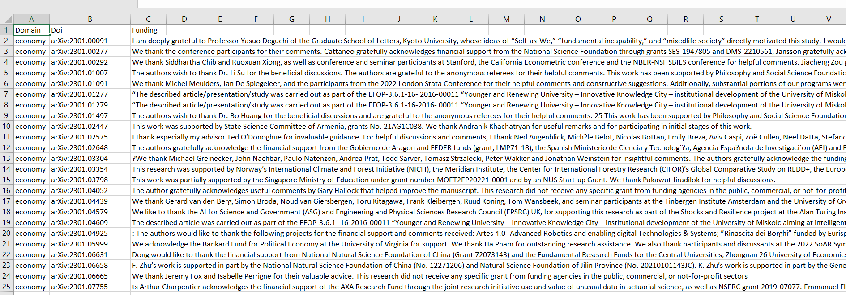

Slide 19
Results

Slide 20
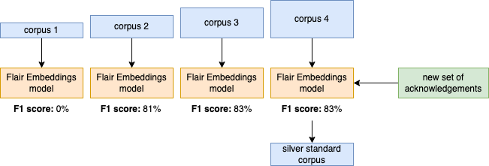

Slide 21
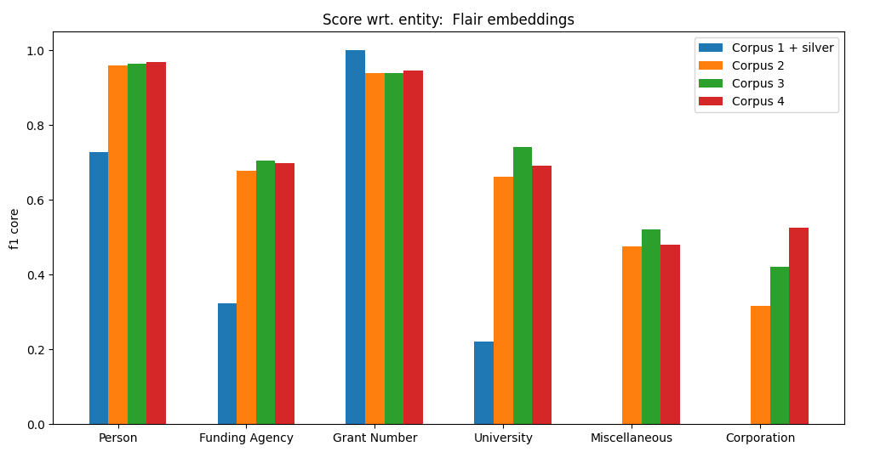

Slide 22
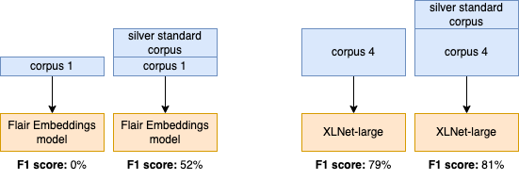

Slide 23
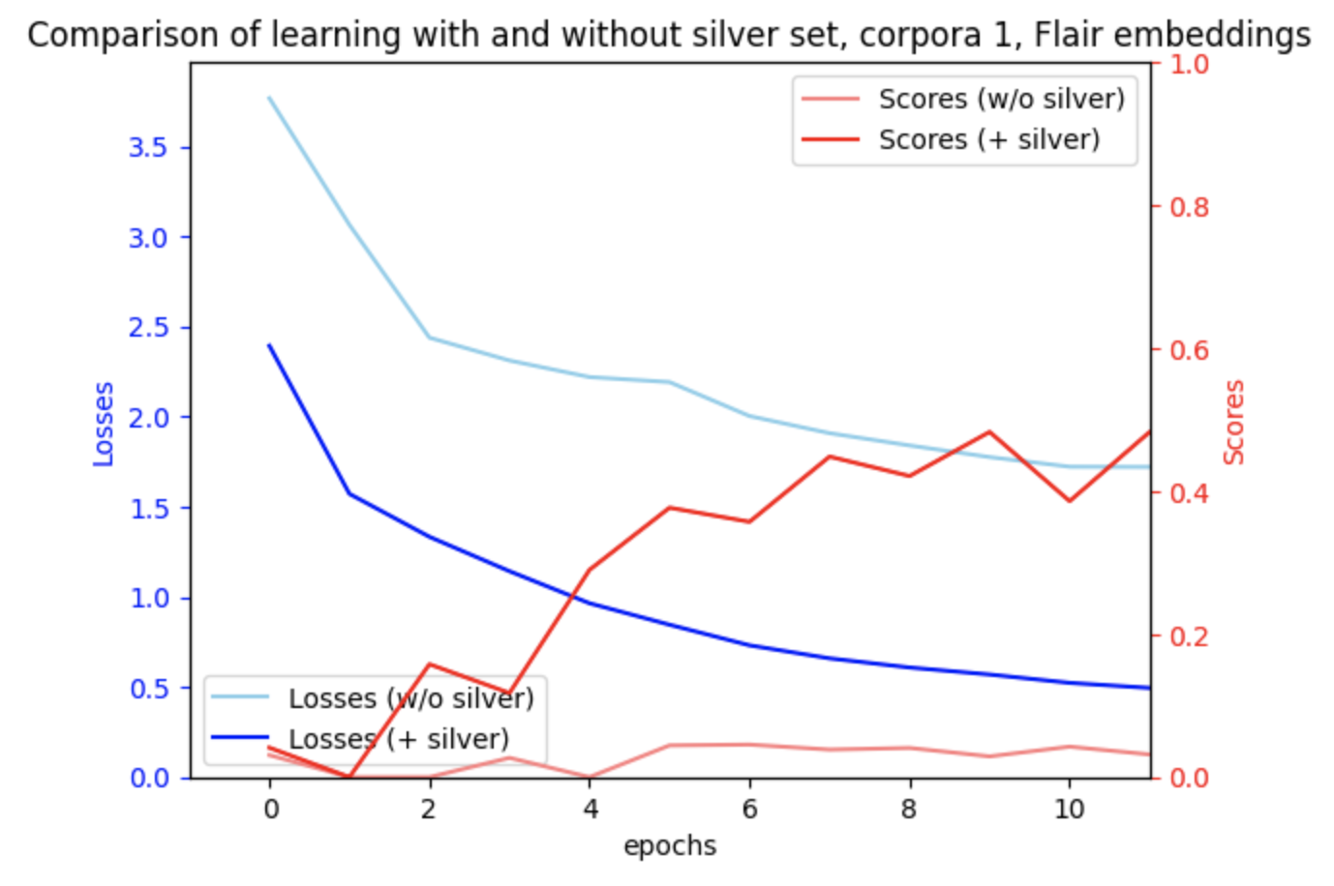

Slide 24
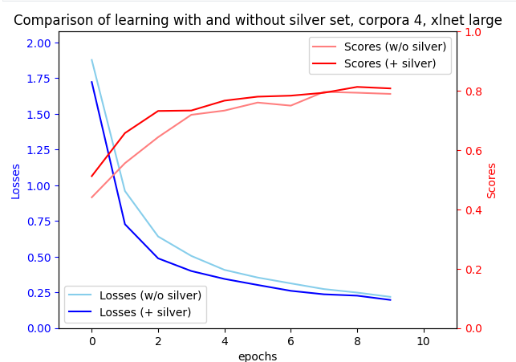

Slide 25
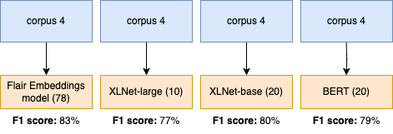

Slide 26
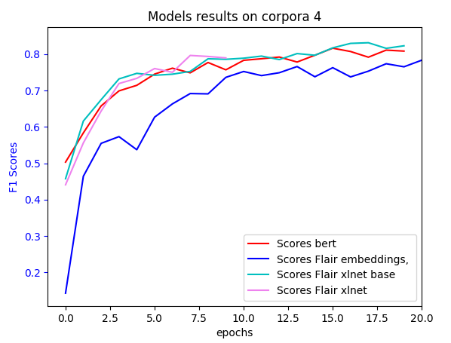

Slide 27
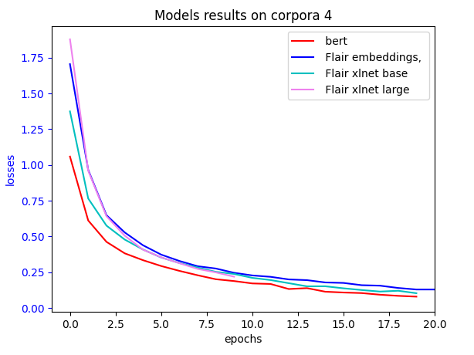

Slide 28
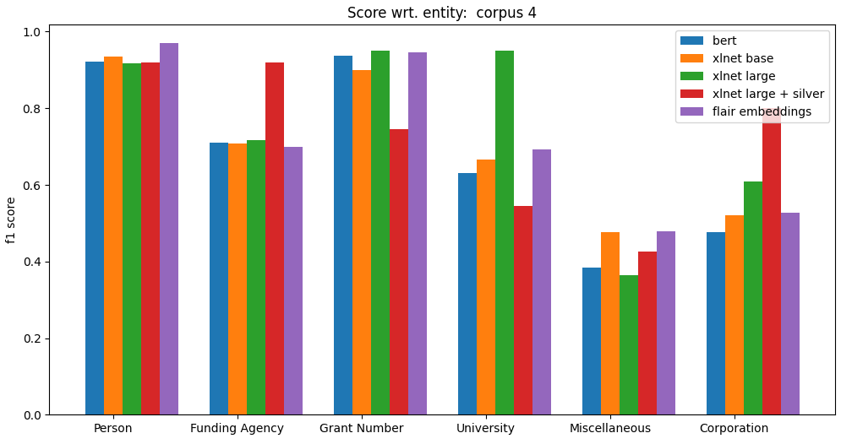

Slide 29
Research questions

Slide 30
Research questions
What techniques and models in the field of NLP are most effective for recognising named individuals in a specific area?
All the models we tested achieved good results, both transformer-based (BERT and XLnet) and from the flair library. It seems to us that XLnet large trained on more epochs would achieve the best results.

Slide 31
Research questions
How does the performance of NER models change with different types and amounts of training data?
As expected, the more data, the better training process. By adding our silver standard set we not only improved decreasing of loss function, but also improved F1 score on test set.

Slide 32
Research questions
Can the use of different text normalisation techniques, such as lemmatization or stop word removal, improve the effectiveness of NER models in identifying entities in scientific acknowledgement texts?
Because of our lack of knowledge about NLP data preprocessing, we thought that such techniques can improve model performance. However, after the research we made, it turned out that these techniques are not used in NER task, because in English language those words are in their proper noun form. Additionally, removing stop words can also affect the model, because in some entity types stop words are important (e.g. grant number). Finally, they can interfere the context of sentences and as the models can understand the context, it’s better to leave them in original form.

Slide 33
Research questions
Can preparing a silver-set and further training models on it improve their effectiveness?
Yes, definitely. Although silver standard is not as precise as gold standard (which requires domain expert), it still can improve effectiveness of the model (taking into account ~80% F1 score). This is a very good news as we can first train model on relatively small amount of gold standard data and then based on this generate huge amount of silver standard data, which then can be used to train a better model. That approach may be beneficial when we don’t have a domain expert or he/she is unable to manually label vast amount of data.

Slide 34
Research questions
Which types of entities are the most difficult to classify?
Not surprisingly, the hardest class is miscellaneous which contains all the entities not classified to any other class. Models had also struggles with corporations but this is mostly because the least amount of examples in the training data.

Slide 35
Thank you.

